Slide 1








Cím: 3525 Miskolc, Palóczy László utca 3.
Telefon: +36 46 500 930
E-mail: kando@kkszki.hu
Weblap: https://www.kkszki.hu
OM azonosító: 203060/015
Felnőttképzési nyilvántartás száma: E-001290/2015
Miskolci SZC Kandó Kálmán Informatikai Technikum
School project

Slide 2
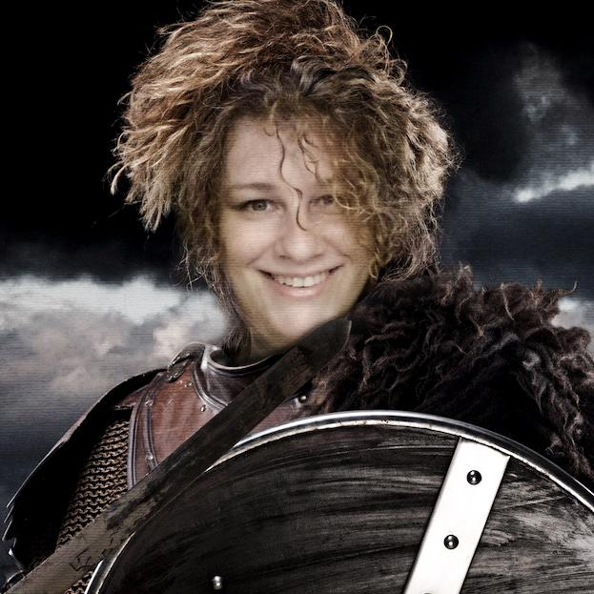
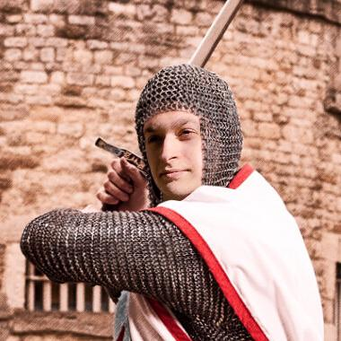
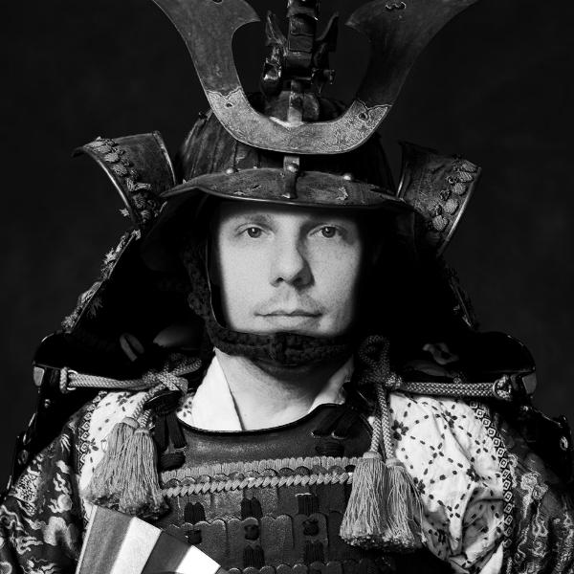
Edit Szigili
Norbert Lekner
Balázs Mészáros
Why make a game?
There is a lot of stress in the world. Games can help you relax or relieve the stress
You can play it with a mobile app or in your browser
Easy to play
Doesn’t require a lot of time
Accessible anywhere at anytime

Slide 3


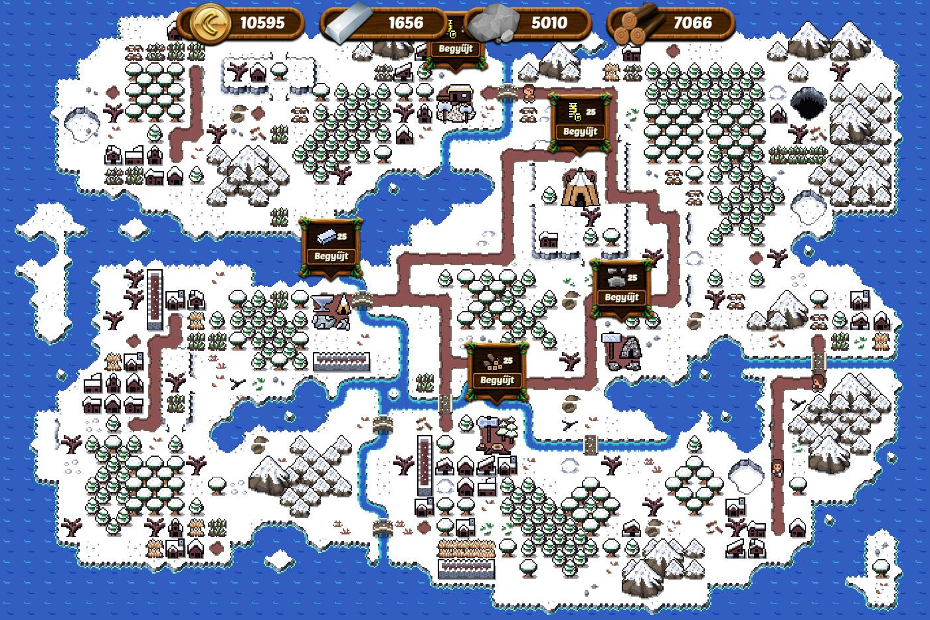
About the game
Choose an island
Battle
Expedition
Build
Upgrade
Collect

Slide 4
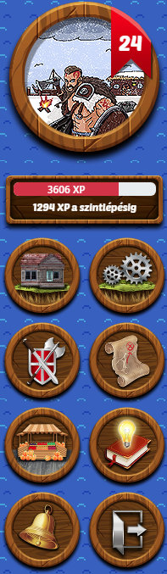
The main parts
Login / Register / Password reset
My profile
Management
Build
Battle
Expedition
Tutorial
Market
Notifications
Music / sounds
Logout

Slide 5
The structure
Database
Mysql + apache
Entity framework
Backend
ASP.NET Core
Swagger
WebAPI / service / authentication
Frontend
React Js
Bootstrap + Npm packages

Slide 6

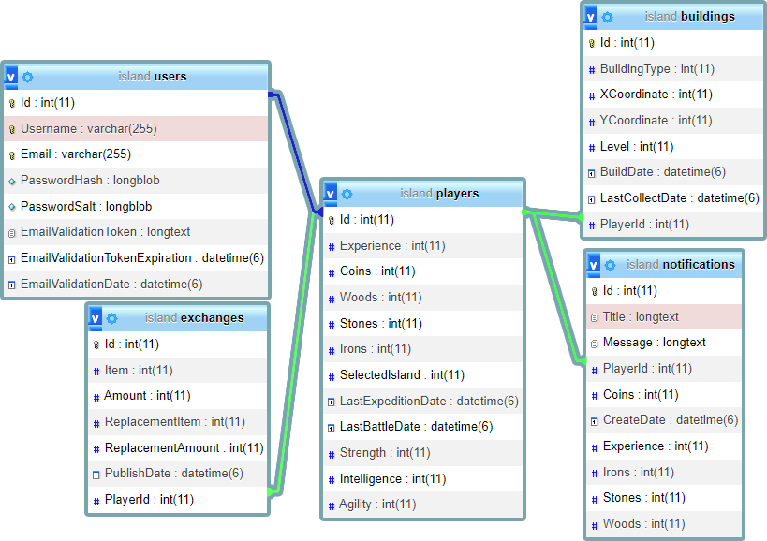
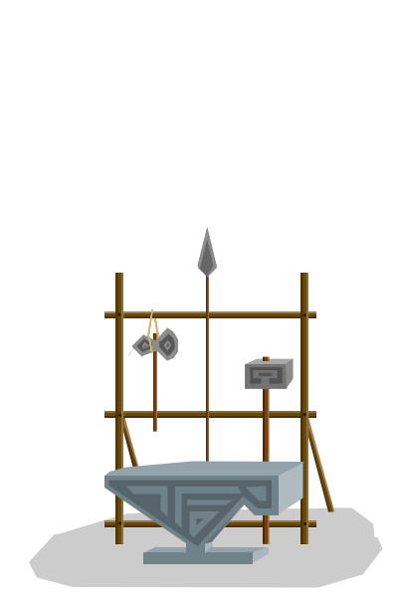
Database
Mysql
Model first
Entity framework
5 tables

Slide 7
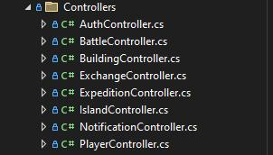
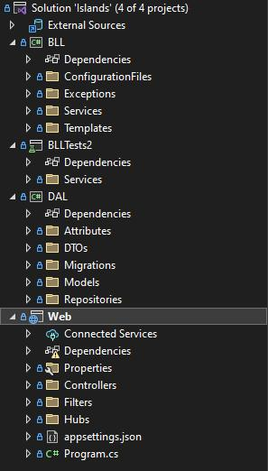

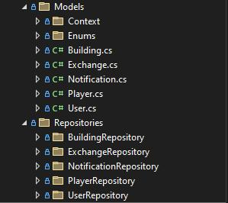

Backend
ASP .NET 6.0 Web API
3 layer architecture
Dependency Injection Design Pattern
Async
Mailkit
Websocket (SignalR)
JSON Web Tokens (JWT)
Password encryption
Entity Framework
Json files for static datas

Slide 8
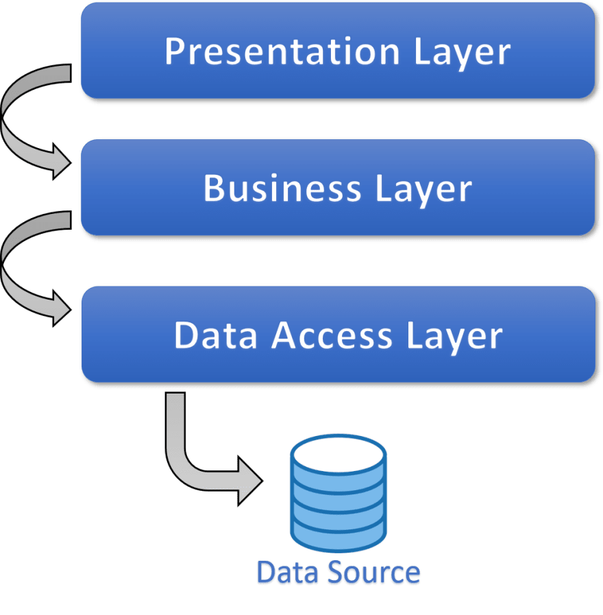
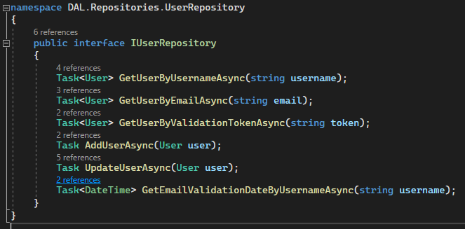
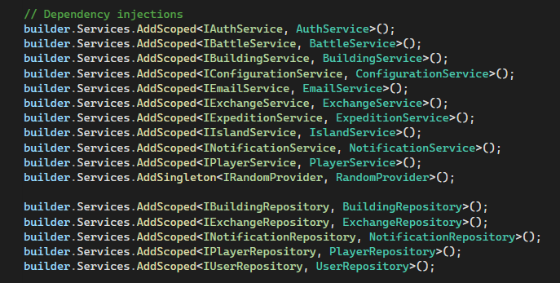
Norbert Backend
3 layer architecture
Data Access Layer, Business Logic Layer, Presentation Layer
Advantages over traditional design patterns: easy to read, maintainable, easier to test
Dependency Injection Design Pattern
Interface, as a dependency - the implementation can be easily changed without changing the behavior of the class to other parts of the code

Slide 9
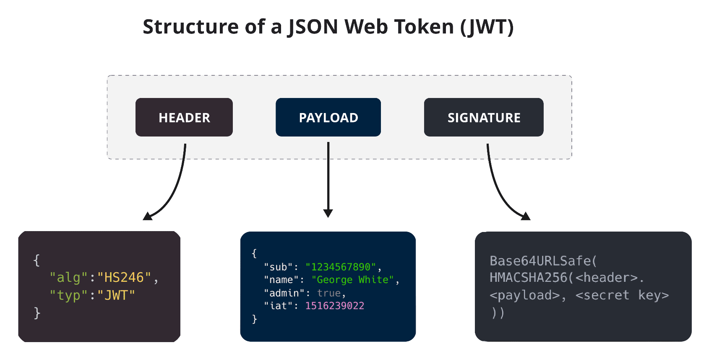
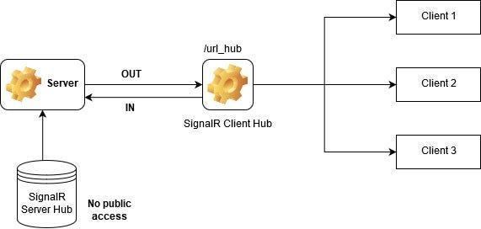
Norbert Backend
JSON Web Tokens (JWT):
It gives you a signed token after logging in, which the server certify after authorization
Websocket (SignalR):
It allows a two-way communication between the server and the browser
It maintains connection (unlike HTTP)

Slide 10
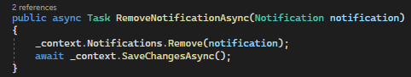
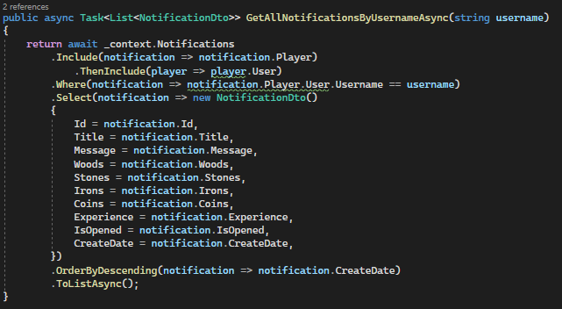
Edit Backend
Notifications

Slide 11
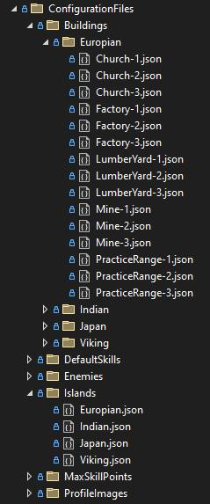
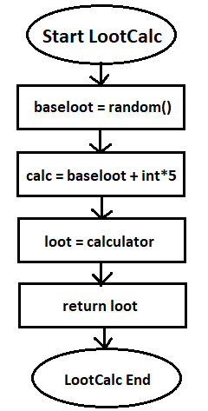
Balázs Backend
Battle and expedition base
Expedition service and controller
Config settings
Balance

Slide 12
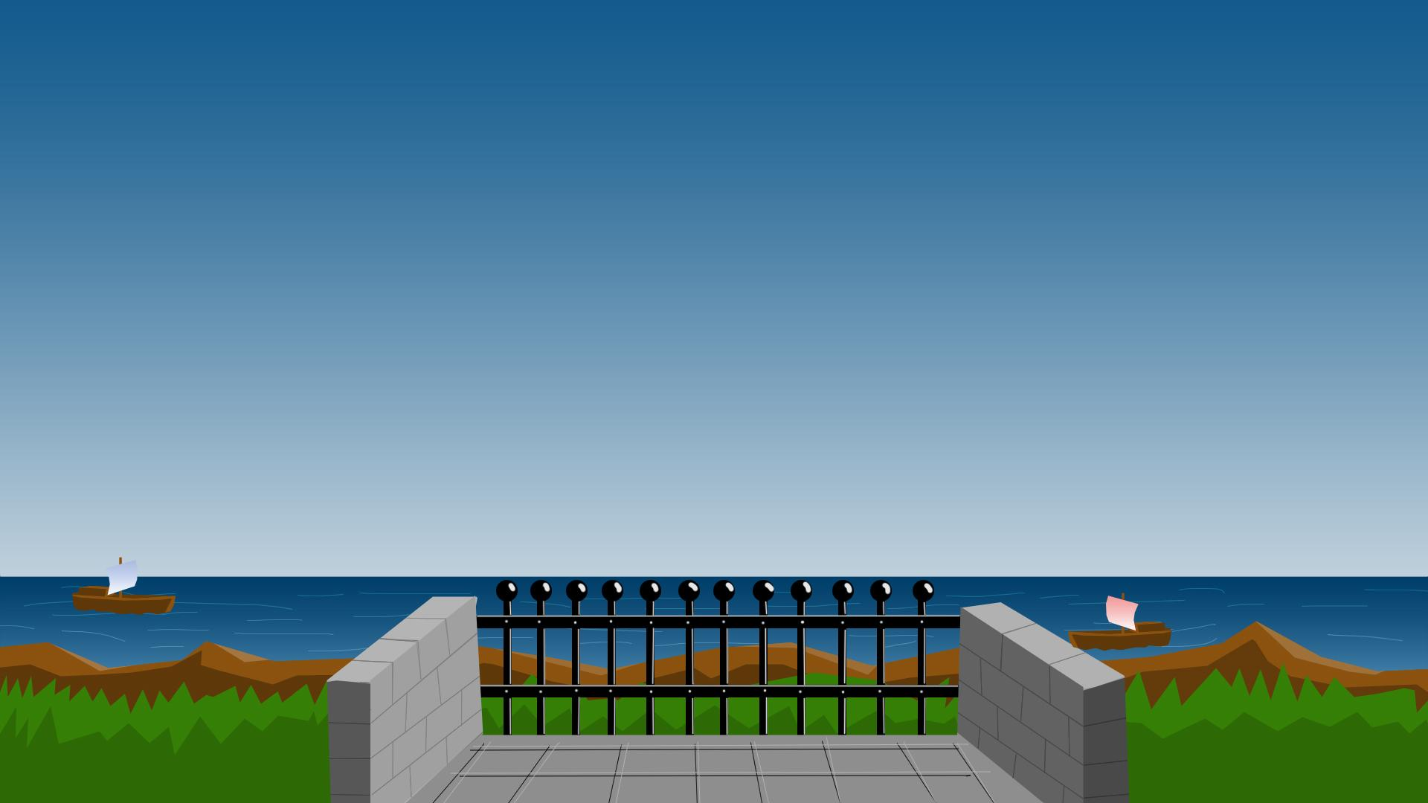
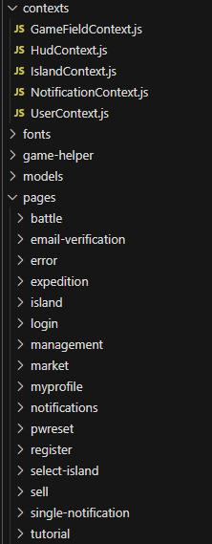
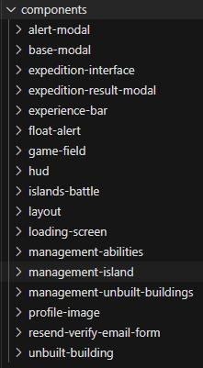
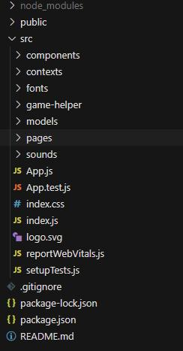
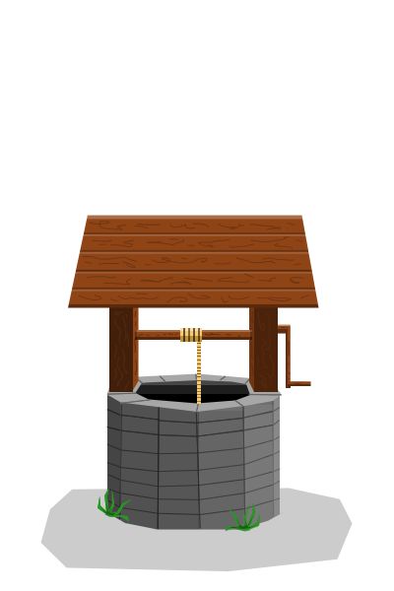
Frontend
React JS
Bootstrap
Rxjs Axios
Moment
React-cookie
React-simple-animate
React-hook-form
Use-sound

Slide 13
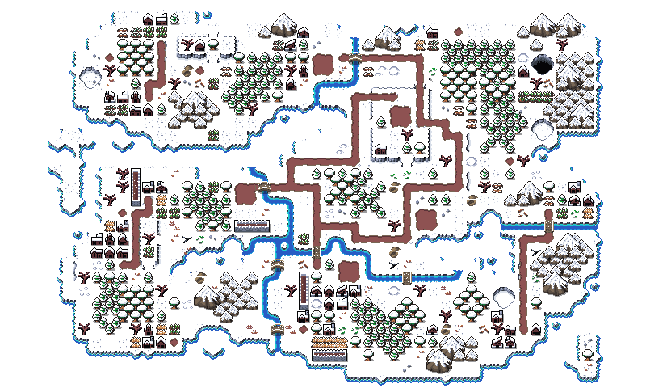
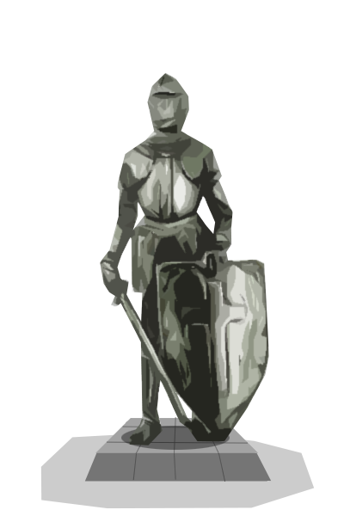












Norbert Frontend
Island and choose an island
Buildings
Battle
Management
Login
Email confirmation
Gamefield
Notifications
Animations
RXJS

Slide 14

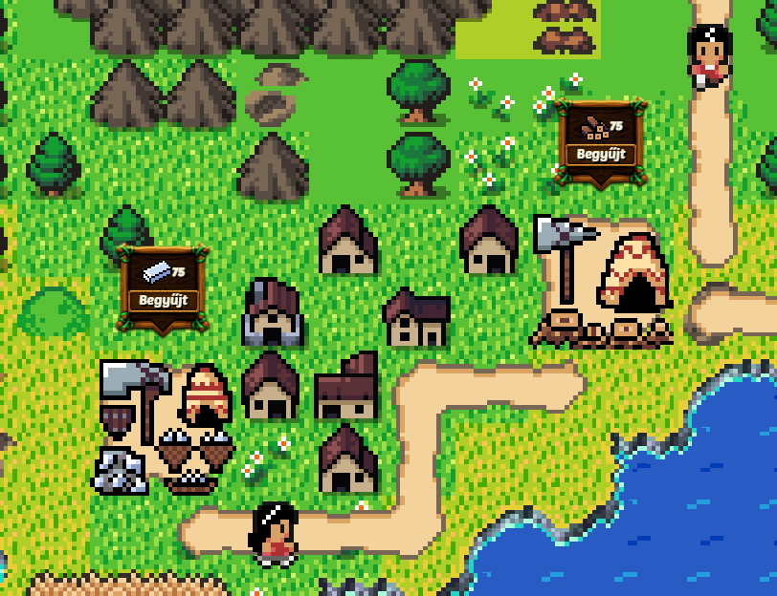
Norbert Frontend
Notifications:
websocket connection
new notifications arrive immediately (with an icon indication on hud)
detailed view
Gamefield:
magnification , moving, touch events
animation rendering
showing objects in grid structure

Slide 15
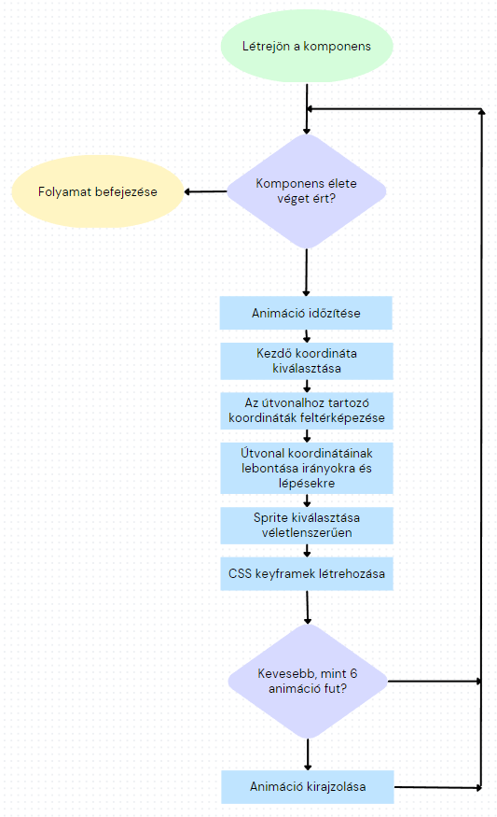
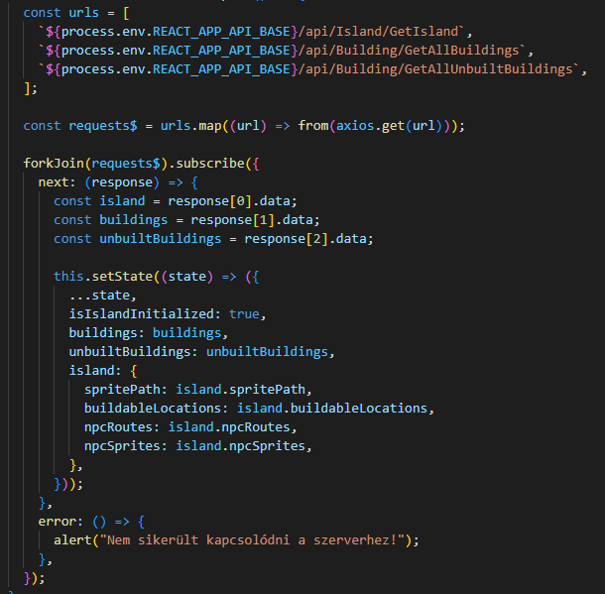
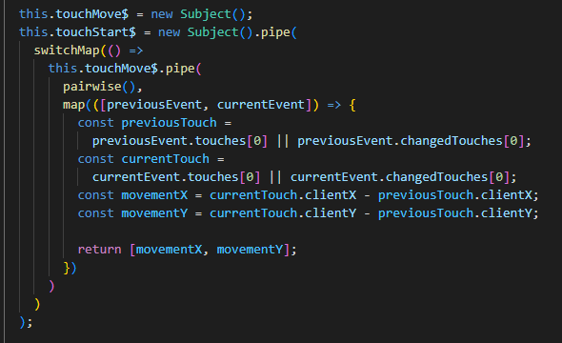
Norbert Frontend
RXJS (javascript reactive programming library):
building production, events, reacting to HTTP requests
Animations

Slide 16
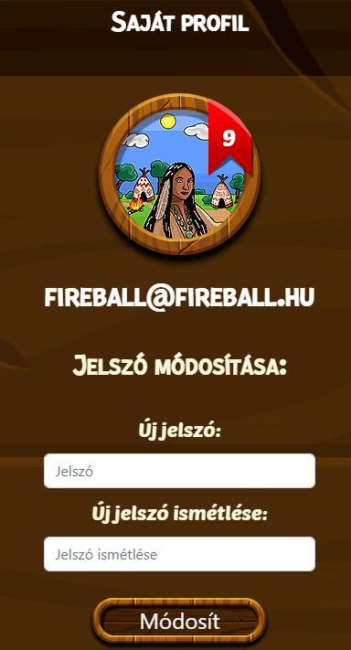
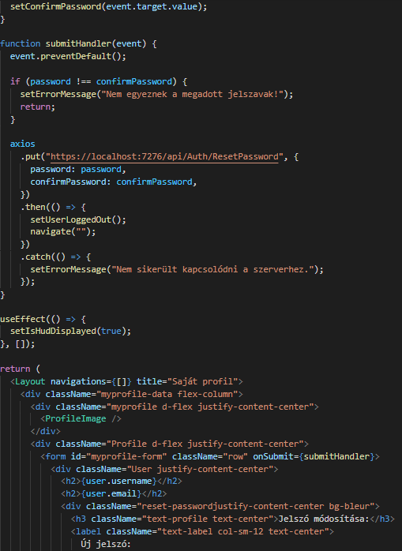

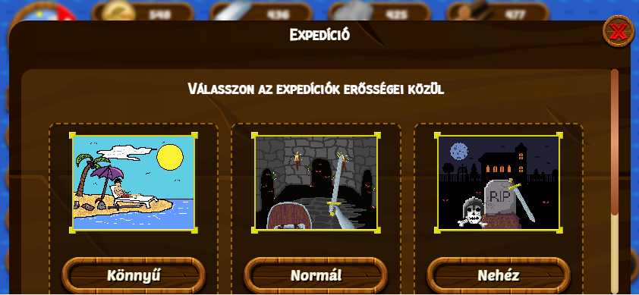
Edit Frontend
My profile
Tutorial
Expedition

Slide 17
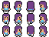
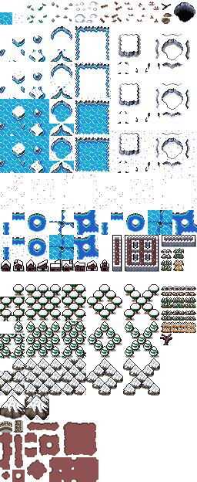
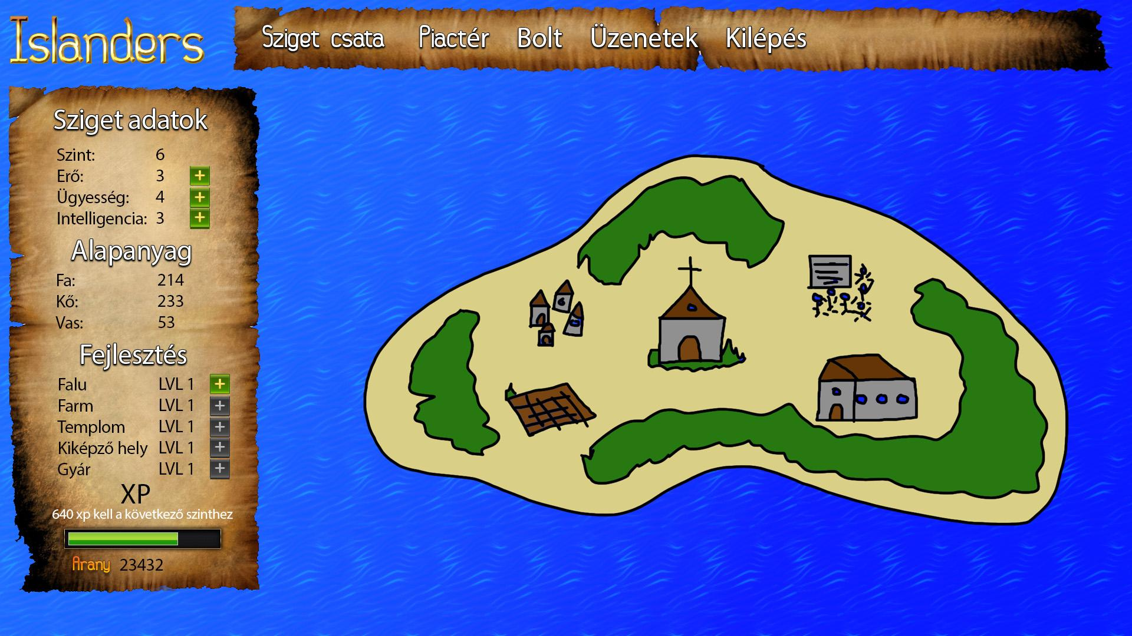
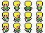
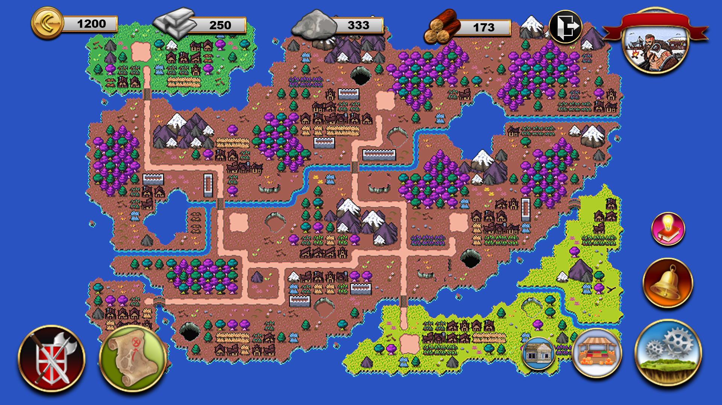
Balázs Frontend
UI / UX
Register
Password reset
Login
Market
Notifications
Music / sounds

Slide 18
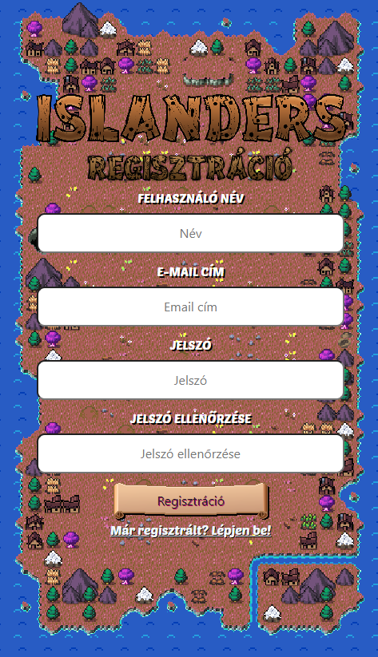
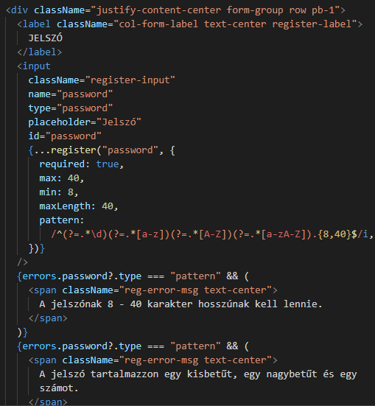
Balázs Frontend
Register
React-hook-form
Error handling

Slide 19
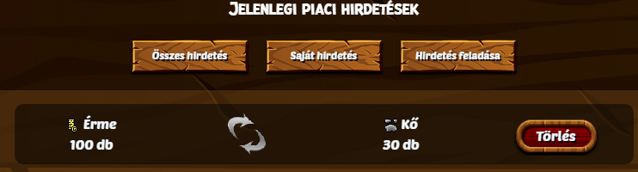
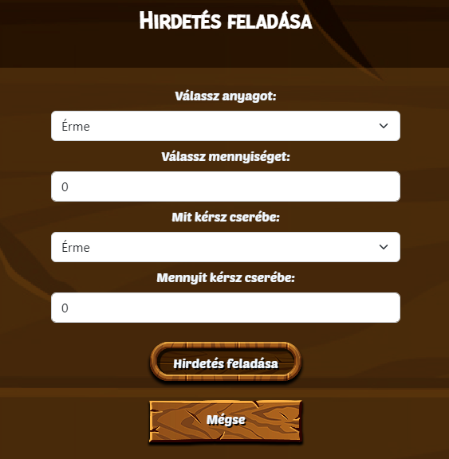
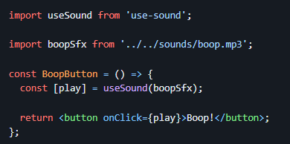
Balázs Frontend
Market
Show exchanges
Managing own exchanges
Posting an exchange
Music / sounds
Playing sounds
Playing music

Slide 20
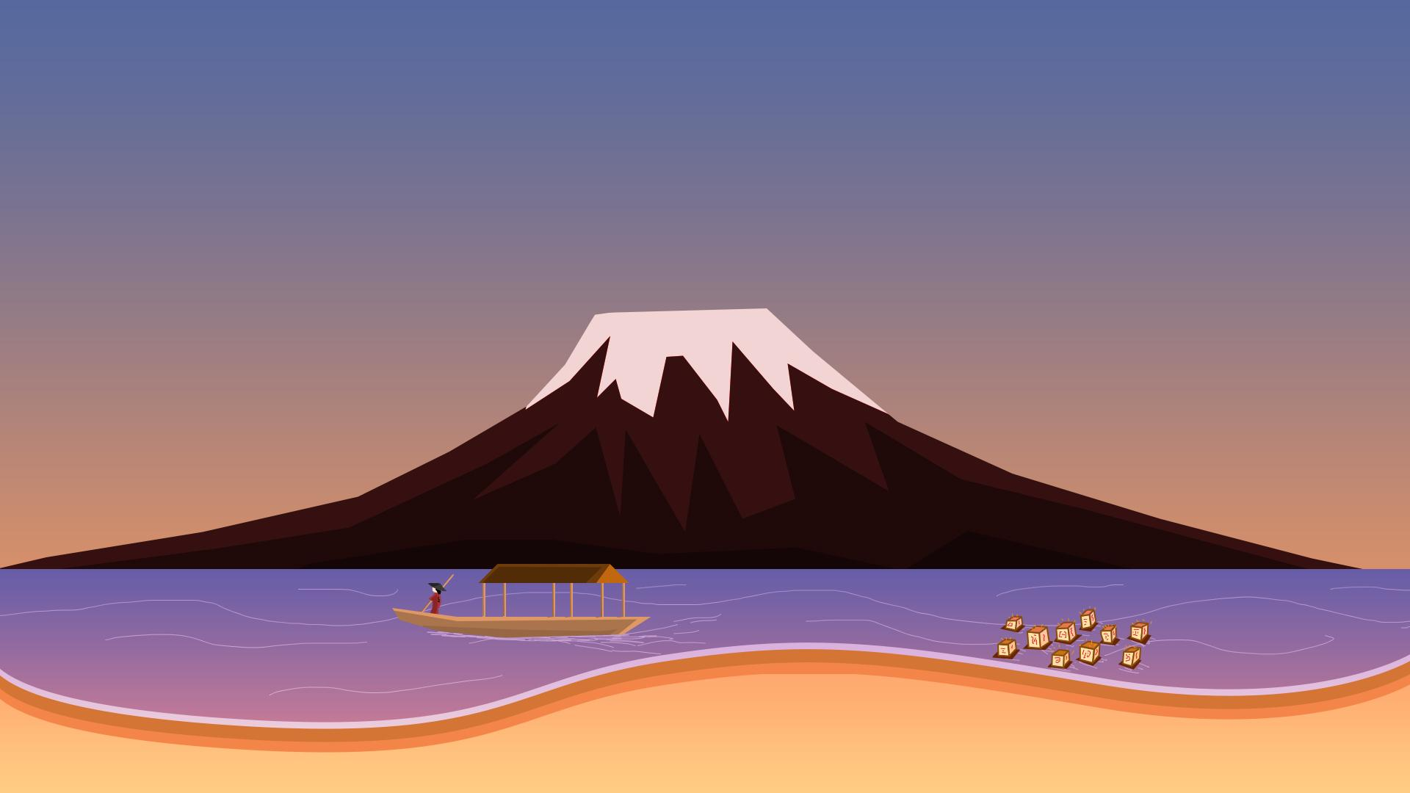

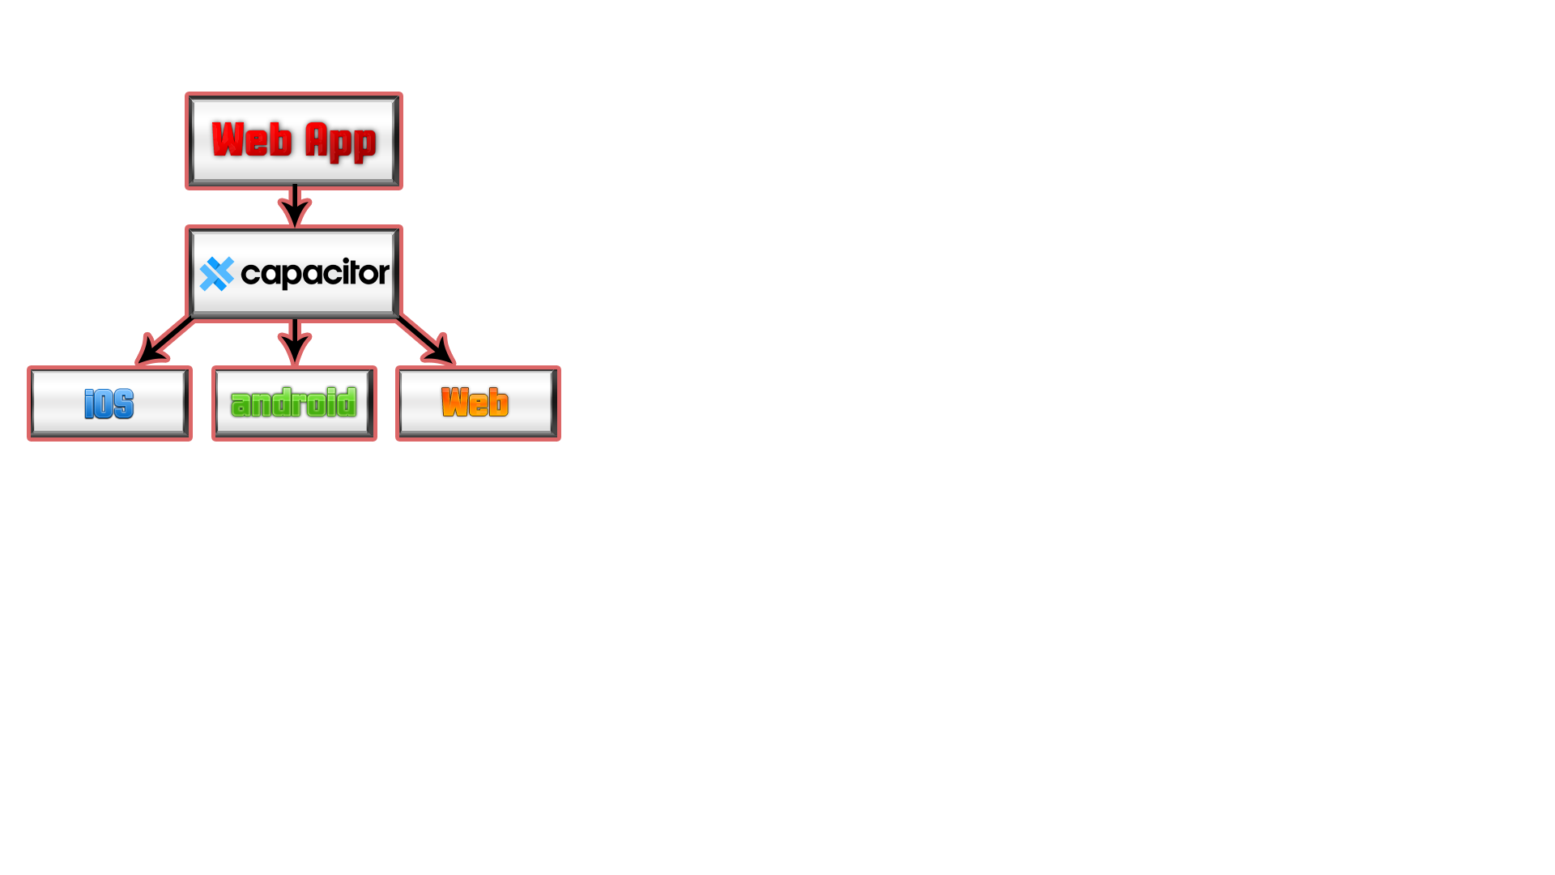

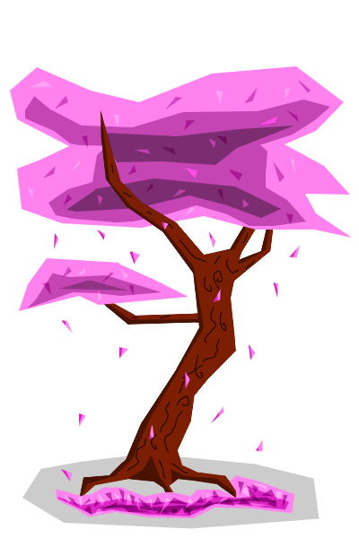
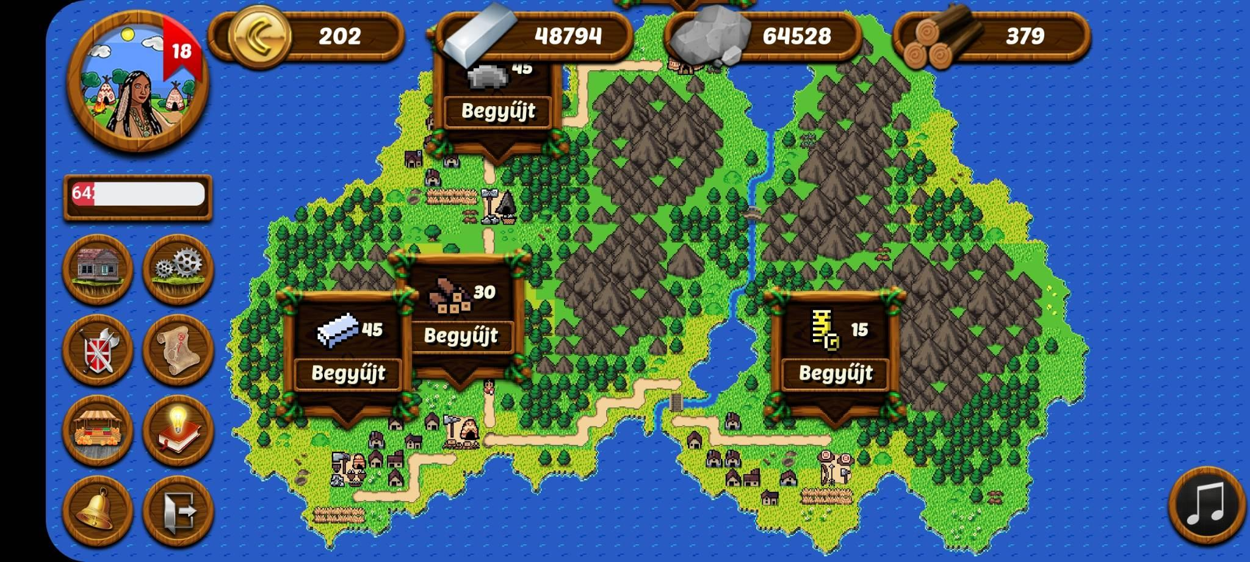
Mobile App
Capacitor
Android studio
Responsive design

Slide 21
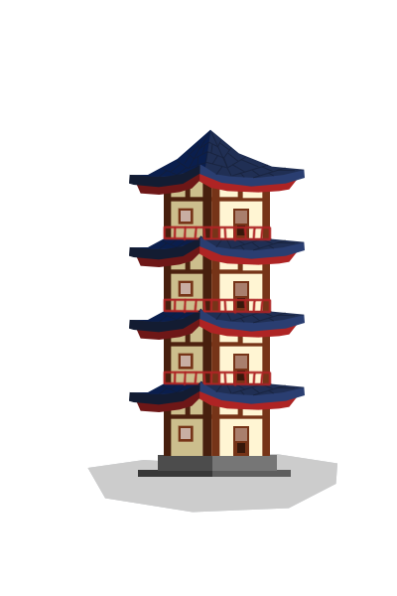
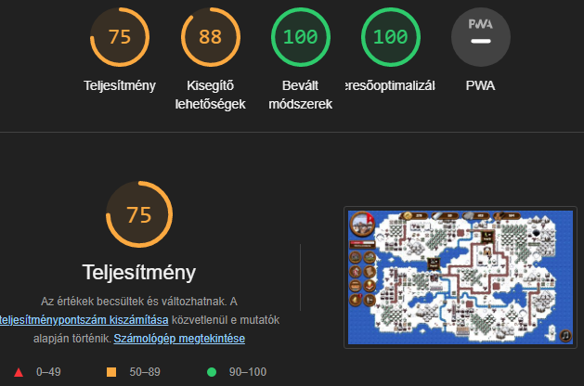
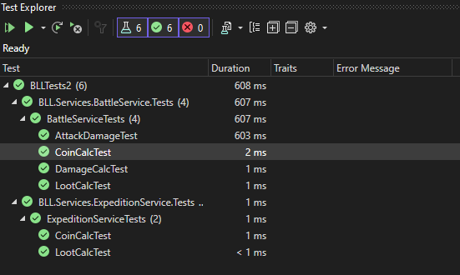
Testing
Functions of battle and expedition
Manual testing
Frontend testing (Lighthouse)

Slide 22


Teamwork
Github (2 repository)
Trello
Discord
Messenger
Google Drive

Slide 23



Publication
SharkASP.net
Firebase
Google Drive

Slide 24
Future development possibility
Microtransactions
Battle / expedition rate acceleration
Changeable profile pictures, Ui elements / skins
Normal mobile app development
Changing to react native
Rewrite the app with kotlin / java
New features
More buildings
Build your own island
Collaborate with other islands (guilds) and travel to other peoples islands
Long expeditions (E.g. going through a cave with 4 small enemies and a boss)

Slide 25
Thank you for your attention!

